Slide 1
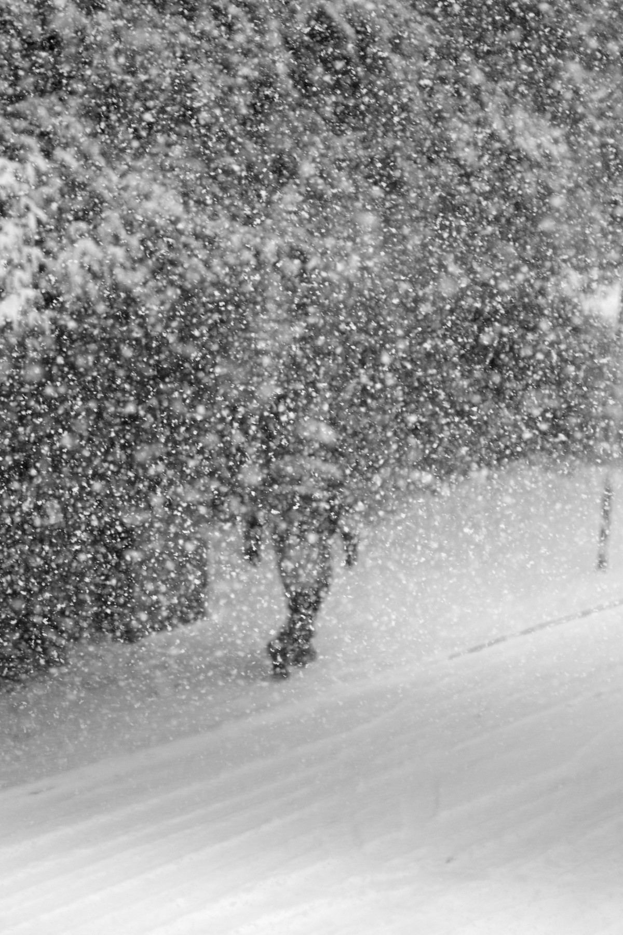
Is a AI winter coming?

Slide 4
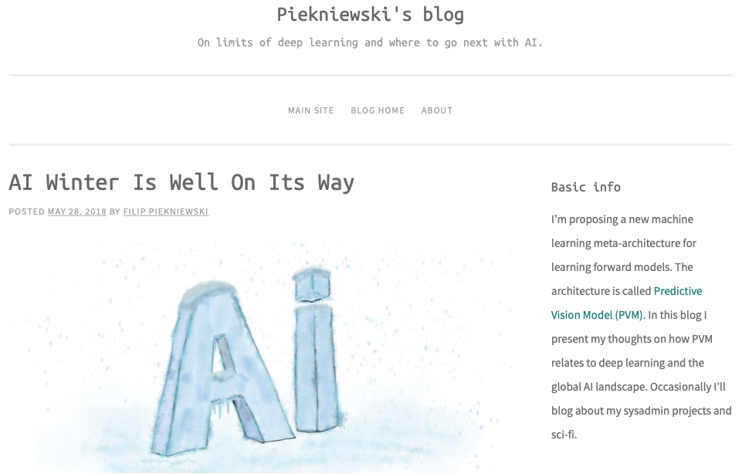
https://blog.piekniewski.info/

Slide 5
If a typical person can do a mental task with less than one second of thought, we can probably automate it using AI either now or in the near future.
Andrew Ng for Harvard Business Review
https://hbr.org/2016/11/what-artificial-intelligence-can-and-cant-do-right-now

Slide 7
http://nautil.us/blog/this-neural-net-hallucinates-sheep

Slide 9
It hasn’t realised that “sheep” means the actual animal, not just a sort of treeless grassiness.

Slide 10
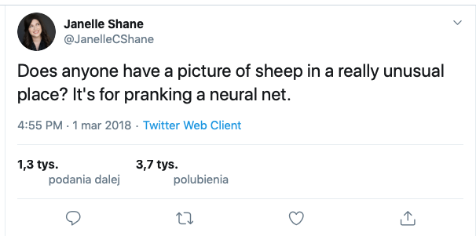

Slide 12
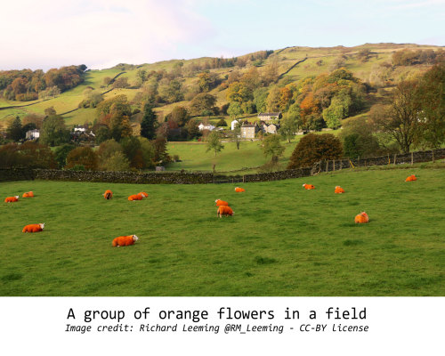

Slide 13
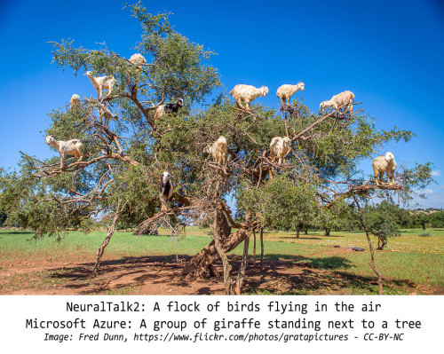

Slide 14
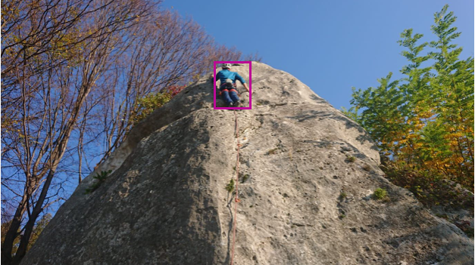
[ { "text": "a man doing a trick on a rocky hill", "confidence": 0.8888406 } ]

Slide 15
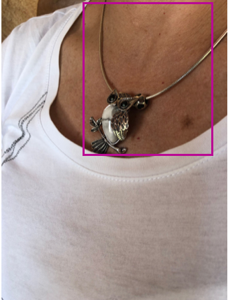
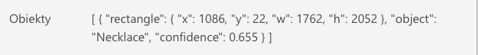
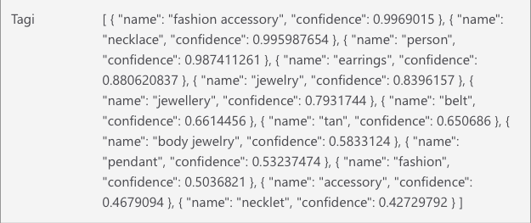
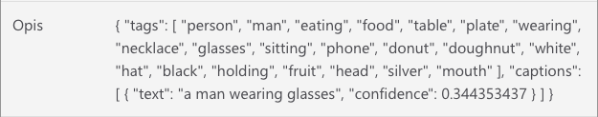

Slide 16
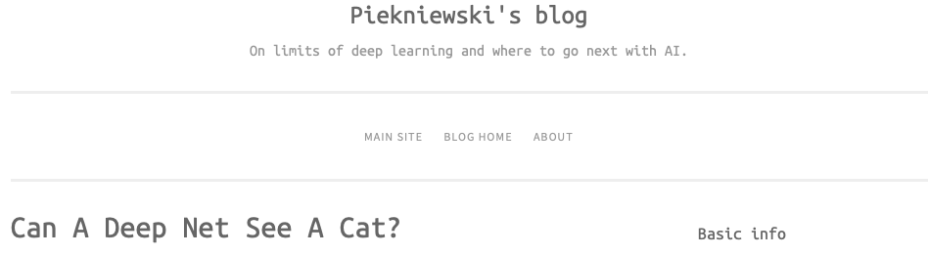

Slide 17
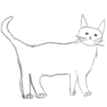
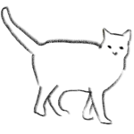
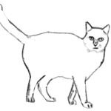
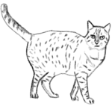
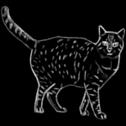

Slide 18
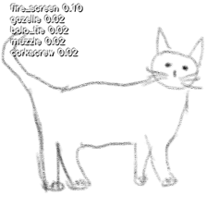
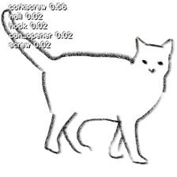
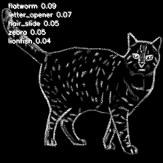
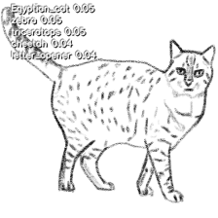

Slide 19
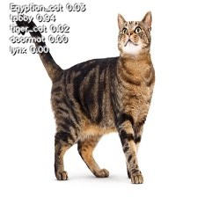
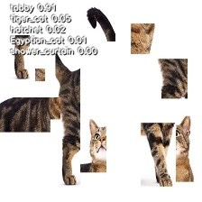

Slide 20
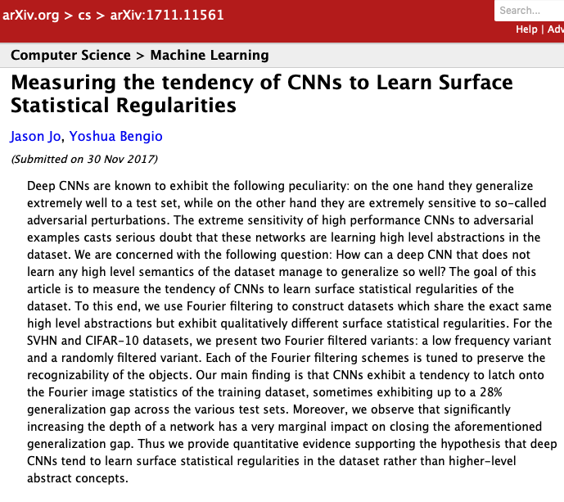

Slide 21
Deep CNNs are known to exhibit the following peculiarity:
on the one hand they generalise extremely well to a test
set, while on the other hand they are extremely sensitive to
so-called adversarial perturbations.
The extreme sensitivity of high performance CNNs to adversarial examples casts serious doubt that these networks are learning high level abstractions in the dataset.
Thus we provide quantitative evidence supporting the hypothesis
that deep CNNs tend to learn surface statistical regularities
in the dataset rather than higher-level abstract concepts.

Slide 25
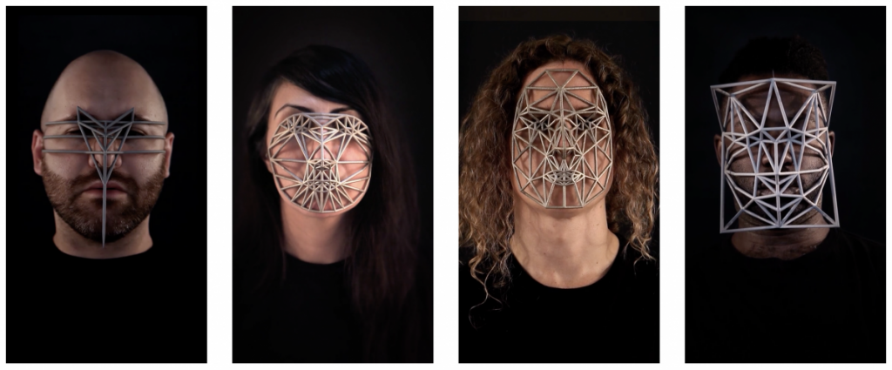

Slide 26
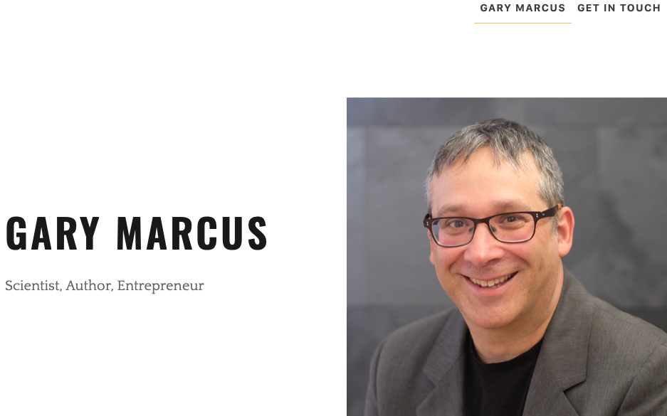
http://garymarcus.com

Slide 27
Deep Learning: A critical Appraisal
Gary Marcus New York University
https://arxiv.org/abs/1801.00631

Slide 28
Deep learning so far is data hungry

Slide 29
There is no such thing as „objective data”

Slide 31
Deep learning so far is shallow and has limited capacity for transfer

Slide 32
Deep learning has so far struggled with open-ended inference

Slide 33
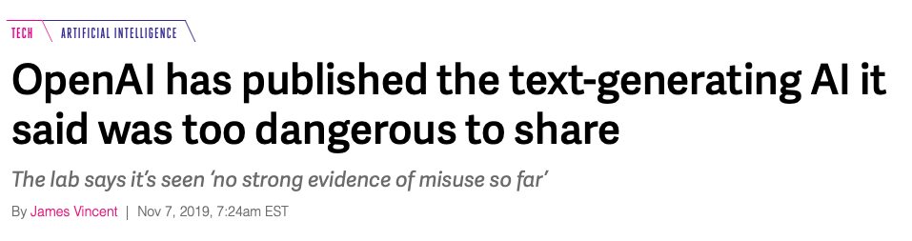

Slide 34


Slide 35
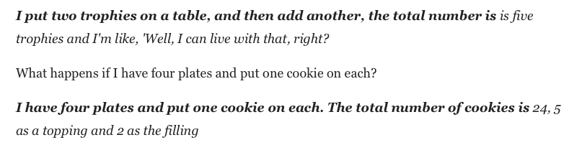

Slide 36
Deep learning so far is not sufficiently transparent

Slide 37
Deep learning thus far has not been integrated with prior knowledge

Slide 38
Deep learning thus far works well as an approximation, but its answers often cannot be fully trusted

Slide 39
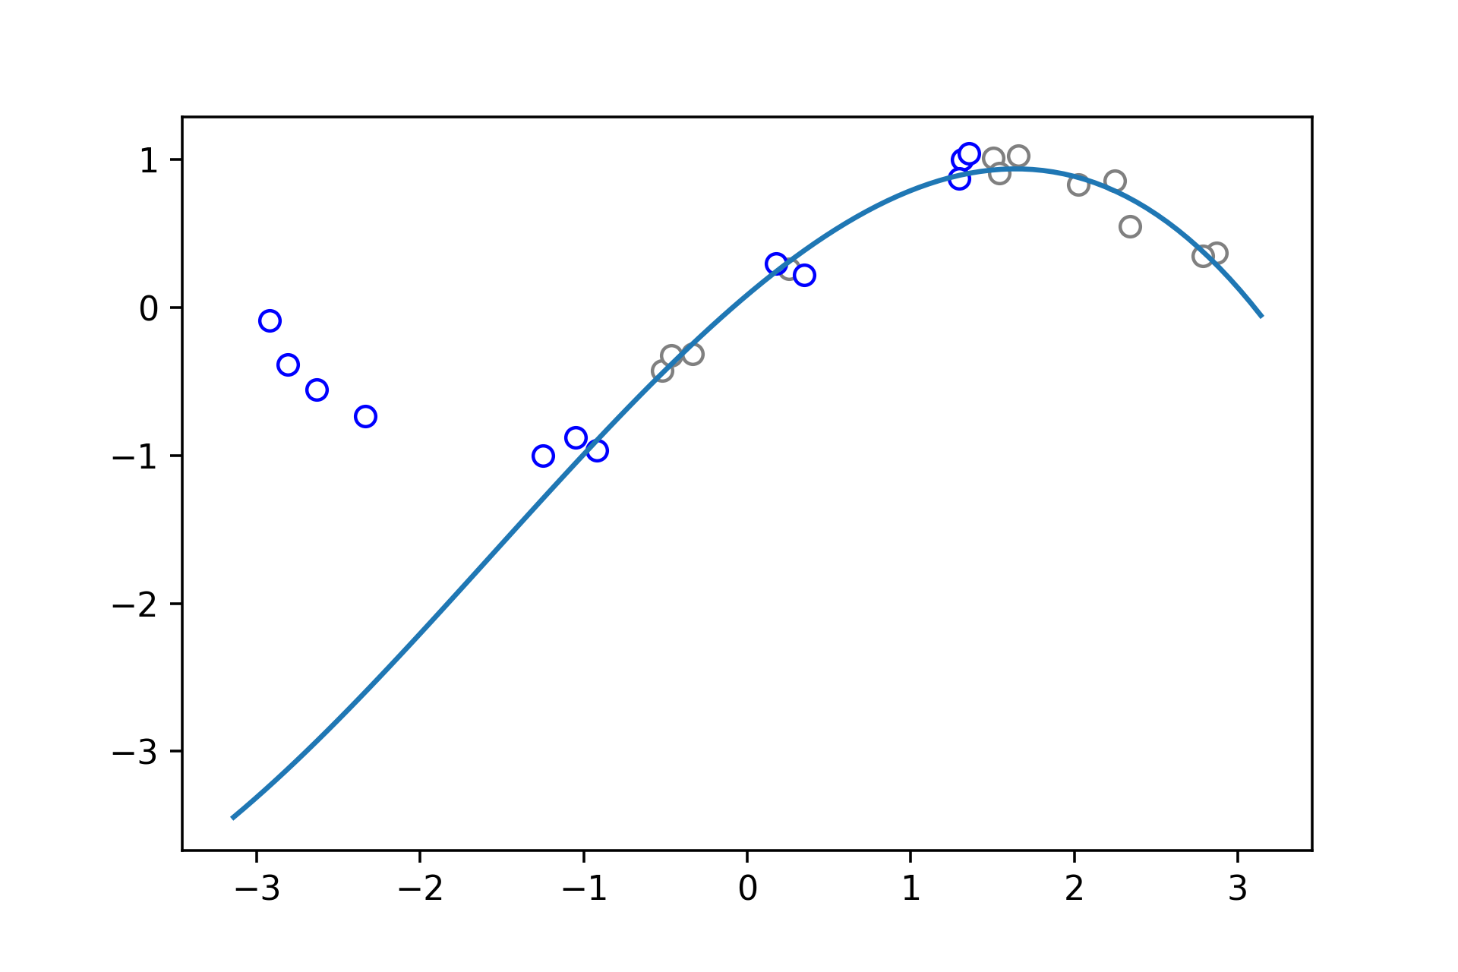

Slide 40
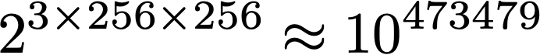
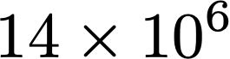

Slide 41
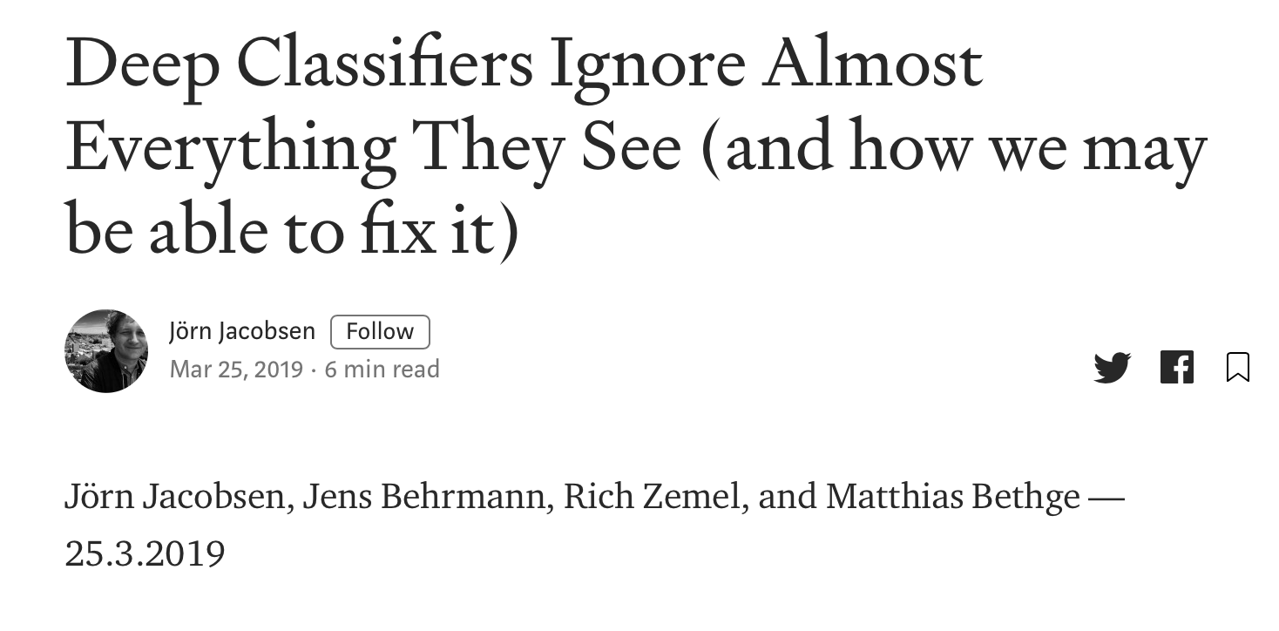

Slide 42
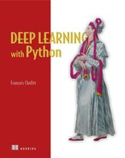
Chapter 9. Conclusions
layered representations learning
hierarchical representations learning
deep differentiable models
chained geometric transforms

Slide 43
Incremental algorithmic innovations.
The availability of large amount of perceptual data.
The availability of fast, highly parallel computation hardware at a low price, especially the GPUs produced by NVIDIA.
A complex stack of software layers that makes this computational power available to humans: the CUDA language, frameworks like TensorFlow that do automatic differentiation.

Slide 44
In general, anything that requires reasoning—like programming or applying the scientific method—long-term planning, and algorithmic data manipulation is out of reach for deep-learning models, no matter how much data you throw at them. Even learning a sorting algorithm with a deep neural network is tremendously difficult.

Slide 45
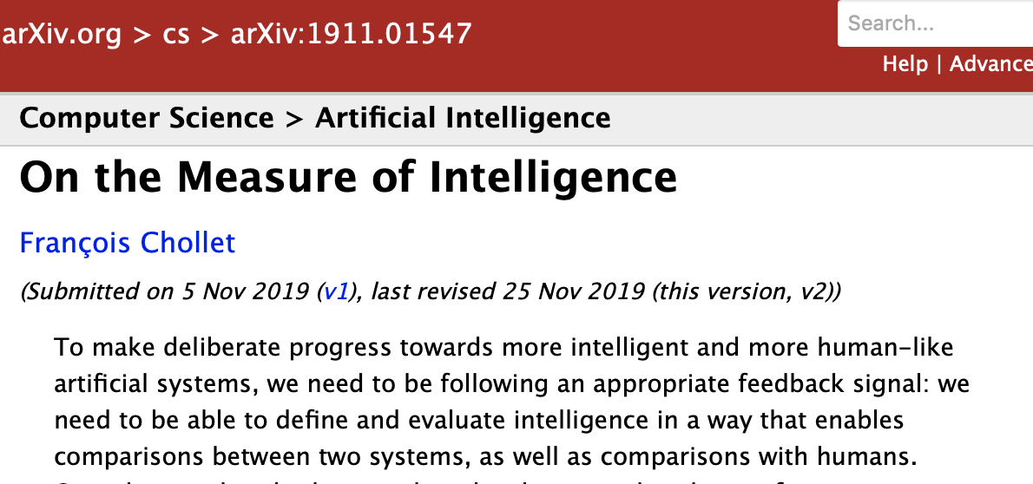

Slide 46
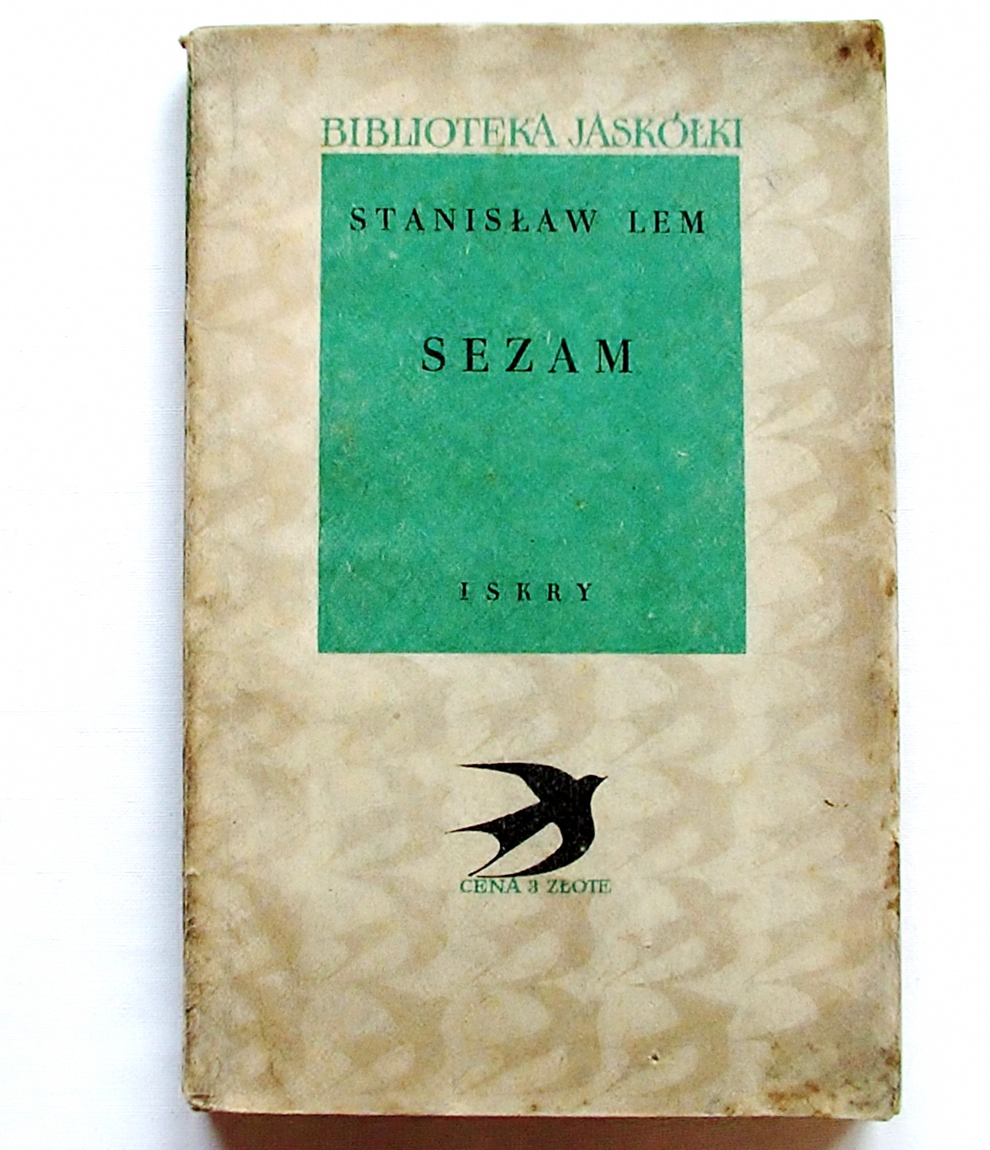

Slide 47
SESAME
"Sesame does not think either," said the professor immediately. The popularisers have done it wrong, emphasising the supposedly remarkable similarity of electro-brains to the human mind. In fact comparison of the Sesame to the living brain is very stretched ..."

Slide 48
"For the same reason that the following experiment would fail. Let's say we want to give someone a way to distinguish any radio station from any other thing in the world that is not such thing. This can be done in two ways."

Slide 49
„First of all, if we know the theoretical fundamentals of radio technology, we'll fill several pages with wiring diagrams, we'll teach him some patterns and we'll tell him: you have here a notebook with plans. If you find an item and you do not know if it's a radio or not, check out the corresponding connections with one of the combinations in the notebook. If the answer is yes, it will be a radio; otherwise it will be something different."

Slide 50
However, there is also a second way. If we do not know the basics of radio technology at all and know nothing about induction, feedback and the whole theory of electromagnetic waves of Maxwell, we will not write „on beef skin” all the traits according to which our man can distinguish radio from non-radio.”

Slide 51
"Let's say all the known radios have at the back of the box
perforated slats. Naturally, this slat will be at the very beginning of our list, because, we will say, since it is in every radio station, then ho! ho! ho! it must be very important! The effect of this will be pathetic. Sesame, which, as you know, is no surprised and does not consider anything impossible, urged by us, he will be obedient to draw up a theory in which the unfortunate slat will take a prominent place."

Slide 52
Interesting what would come out of it! Even if he gave him a million and a trillion of further descriptive qualities, nothing will help. Sesame will choke on this idiotic board, which he is in no way able to fit into the theory, and in addition he will not know anything about the most important thing - about the existence of the broadcasting station, without which the radio can not play at all ... There is no doubt that even after a thousand years it will not discover the Maxwell's theory, because how could he? " He will manipulate "abstractions" of boards, "generalisations"
of boxes, will dig in thousands of descriptions and give birth to the greatest nonsense imaginable!

Slide 53
